Slide 1


Understanding Crime Activity in England
Joshua Kaplan
Tim Ahn
John Hotchkiss

Slide 2

The Importance of Understanding Crime
Educate populous
Reduce crime
Identify police abuse
Notes:
For our project, we decided to find a way to use the UK police database, a public database that contains information on all of the crimes in the UK, submitted by police departments. Our primary goal in this massive data project was that of a data scientist, to take data that is largely unintelligible in its raw form, and turn it into knowledge. Why is crime data worthy of such an effort? By gaining a better understanding of crime, and distributing that knowledge, one can contribute to the health of society. Here are three ways that might happen.
One clear benefit of understanding crime data is to educate the citizenry. Before people decide where to live, for instance, it may be really helpful to look at a map that makes all of the data consumable.
A full understanding of crime will also yield hypotheses for how to reduce it, paving the way for policies and programs in government.
Finally, once the intricacies of crime are understood, it will be easier to identify what police action is contributing to crime prevention and which may be abuse.

Slide 3
Data Sources
Crime data from https://data.police.uk/
Published by the “Home Office” department of the UK government
Published monthly
Started 12/2010
Economic data from https://www.nomisweb.co.uk/
Published by the Office for National Statistics
Access through “Query data”
Crosswalk files for aggregating data to the Local Authority District (LAD) level correctly from http://webarchive.nationalarchives.gov.uk/20160105160709/http://www.ons.gov.uk/ons/guide-method/geography/products/census/lookup/2011/index.html
Published by the Office for National Statistics
Shapefiles for mapping output areas from https://census.edina.ac.uk/easy_download.html
Published by University of Edinburgh
Notes:
These are the data sources that we used. Most of them were found through googling. The dataset that kicked it all off was the crime data. A link was posted to it in the sub-reddit datasets.
The first is a UK-wide crime database I already spoke of.
The second is the source for the Economic indicators that we evaluated.
The third contained the data required to aggregate from the street level crime data to the local authority district (LAD) level that we ended up applying for the majority of our analyses.
The fourth contained the shapefiles that we needed to create the mappings.

Slide 4

Agenda
Inspiration/Previous Work
Exploratory Data Analysis and Mapping
Discussion of Tools
Discussion of Analysis
Timetable of work
Possible Extensions
Notes:
Basically read the slide. I don’t know what else one does with an Agenda slide

Slide 5
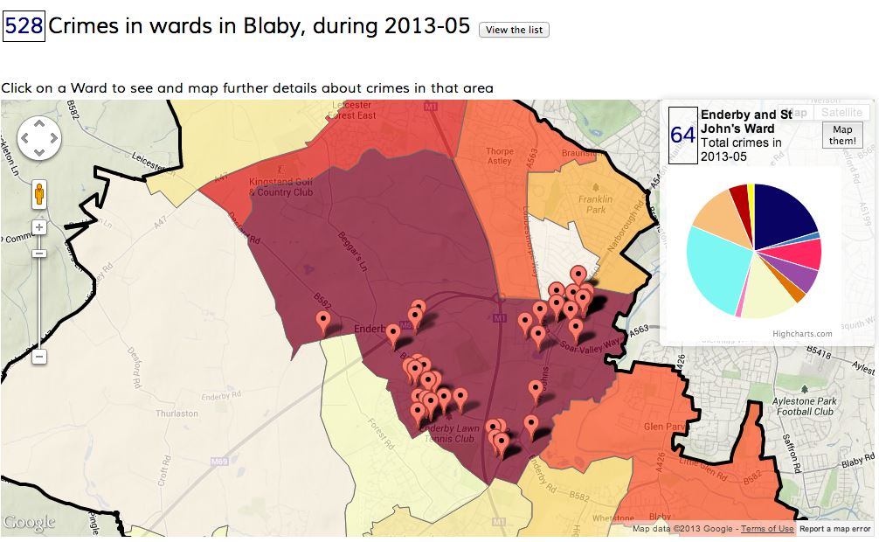
Previous Work
Discontinued website

Slide 6
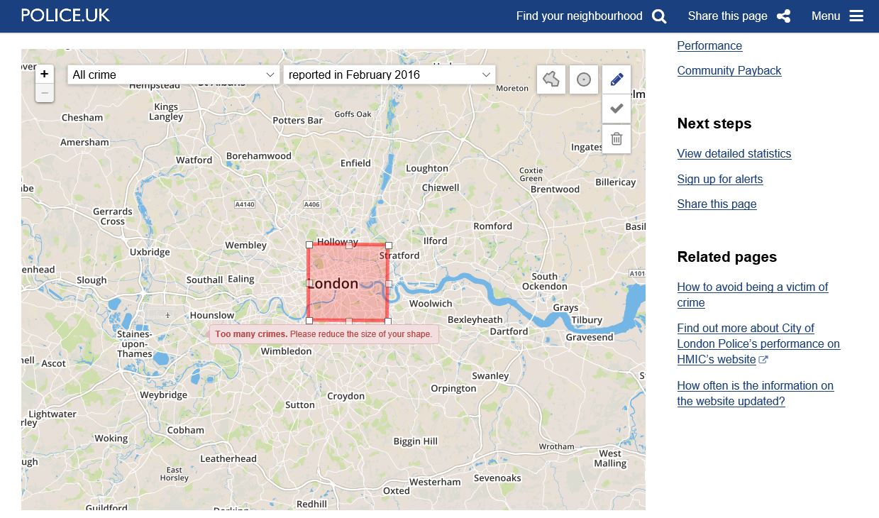
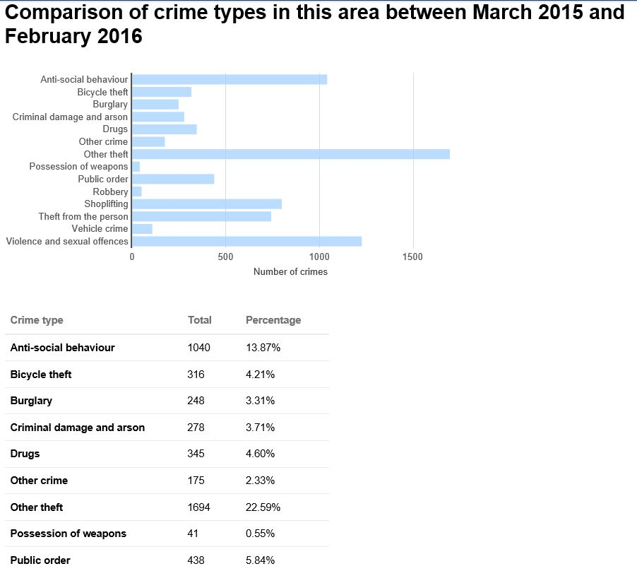
Previous Work
City of London Police website

Slide 7
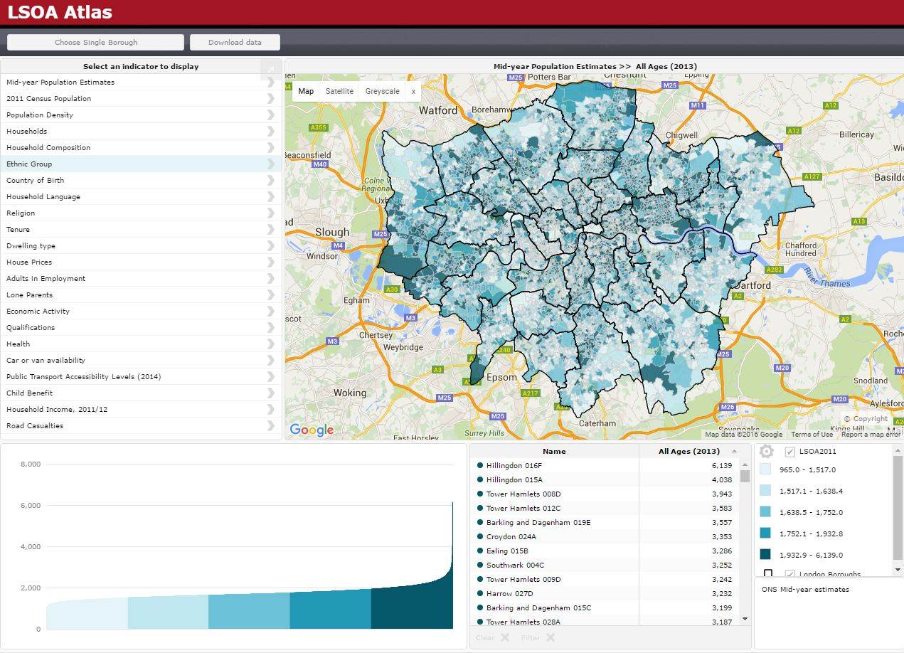
Previous Work
London Datastore – data.london.gov.uk

Slide 8
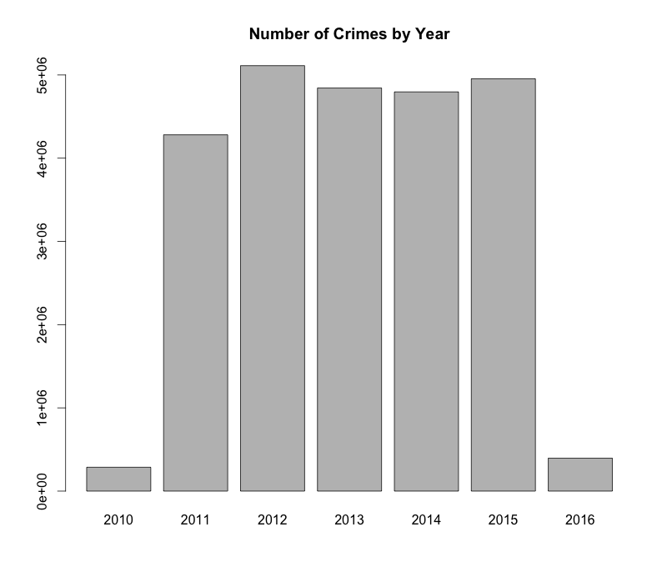
Exploratory Data Analysis
Crime Data
Total incidents: 24,668,162

Slide 9
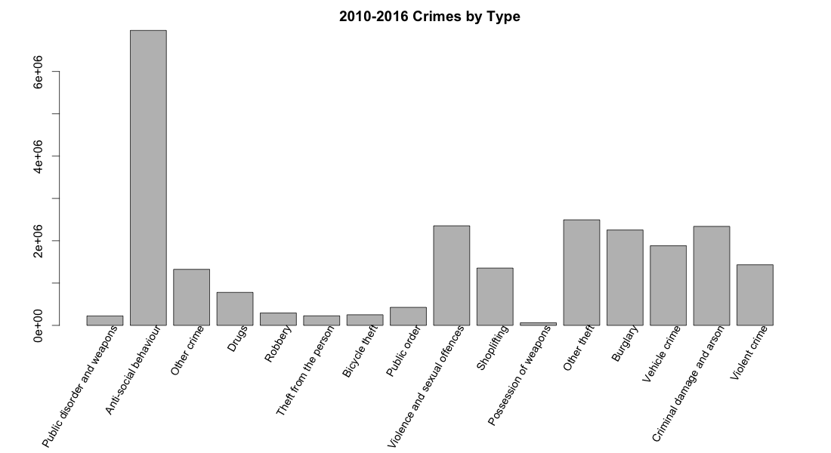
Exploratory Data Analysis
Crime Data

Slide 10
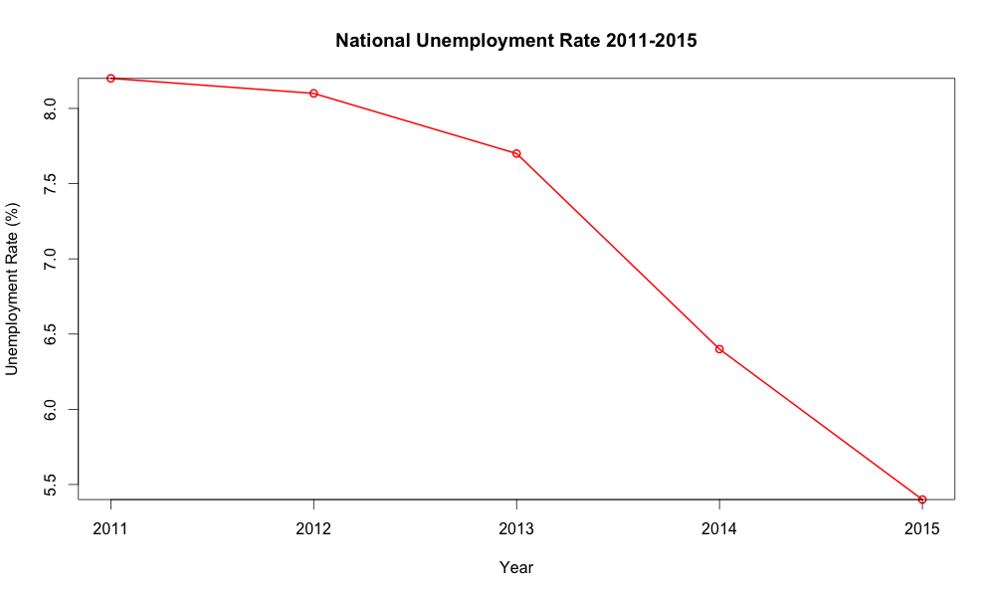
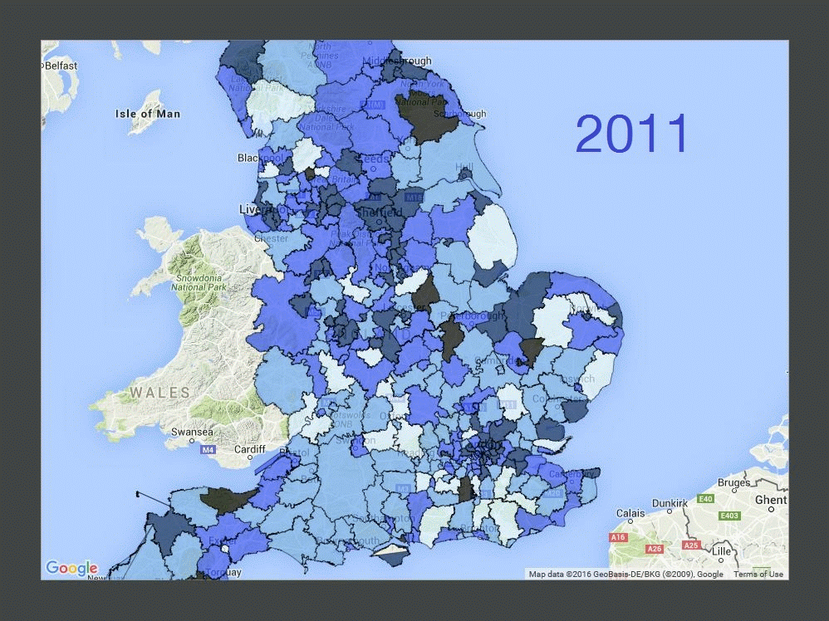
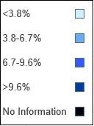
Exploratory Data Analysis
Unemployment Data
Year-district observations: 1905
• 120 No Unemployment Information

Slide 11
Exploratory Data Analysis
Shapefiles
Kensington and Chelsea:
[[523042.5995562461, 182738.30144709907], [523036.5006122405, 182711.5996230743], [523191.1000363843, 182743.30061510392], [523317.5005485022, 182719.2017990814], [523713.20077287056, 182585.8995269572], [523850.4003889982, 182510.00064688642], [523885.30035703094, 182376.40141476202], [524084.3004212163, 182397.59821478184], [524459.100805565, 182336.8995907253], [524558.7974456579, 182283.70279067568], [524705.2007737944, 182033.60103044286], [524862.7022139409, 181957.7021503721], [524938.0010300113, 181733.50144616328], [524796.2999098792, 181750.99751017964], [524720.898693809, 181718.39744614926], [524886.7006779637, 181408.29338186048], [524937.599622011, 181429.30176588008], [524996.3997500658, 181305.00045376434], [525053.799046119, 181051.00134952762], [525339.4008383851, 181111.5013175842], [525394.7009344364, 180854.79885334498], [525418.3000384585, 180748.99917324656], [525493.0991425284, 180757.19936525403], [525556.8021825876, 180542.30067705386], [525848.0994628586, 180584.10035709292], [526126.1994311179, 179657.9005482304], [526399.4005833722, 179627.7027882021], [526462.7001674313, 179219.49952382199], [526878.2004558181, 179279.10246787756], [527233.600136149, 179377.0009639687], [527289.1009362007, 179298.20211589523], [527414.2009683175, 179406.1030439958], [527436.399240338, 179346.00243593985], [527633.6994645216, 179528.49766810983], [527739.40288862, 179675.50106024672], [527914.2979927829, 179753.3987883192], [527965.2010328306, 179395.0008359854], [528096.1993049525, 179230.60173183237], [528153.600649006, 178959.8008355801], [528106.9984089627, 178895.19872351992], [528178.1008730286, 178826.0008994555], [528112.3006809677, 178751.5028513861], [528197.1001690465, 178615.80237125978], [528128.8997209829, 178557.1005472052], [528138.3000409917, 178512.80025916384], [528176.2003290269, 178402.30041906098], [528130.4009049844, 178351.89913901407], [528534.4999773607, 177971.1001626593], [528563.2006493874, 177801.30253050127], [527393.2007762978, 177529.80326624843], [527392.5003602973, 177529.60256224824], [527107.2999760315, 177444.9996821694], [526939.8001998754, 177357.2019220877], [526811.6998477562, 177248.80128198676], [526640.4993355966, 176973.50092973025], [526473.4009674413, 177002.19955375697], [526321.3001032996, 176931.00083369063], [526251.9998792352, 176933.70214569313], [526112.6990151054, 177077.10310582677], [526027.6005190259, 177216.20121795638], [525904.4010309114, 177334.30118606635], [525723.7981507431, 177575.10093029053], [525520.2986305535, 177864.80281856027], [525351.6970303964, 178034.10483471793], [525320.2008383672, 178014.80243470008], [525189.2005182451, 178113.50169879198], [524894.3008059703, 178502.80192315462], [524930.4009020042, 178525.00019517518], [524846.6991419264, 178683.59936332284], [524536.3001656372, 178990.60275560874], [524494.099077598, 178975.5048995947], [524356.0003894691, 179167.40249977354], [524055.59974918957, 179493.10208407673], [523993.60064513166, 179662.000644234], [523845.9992369942, 179898.89894845476], [523843.69933299185, 179902.99904445861], [523773.2993329263, 180084.40269262763], [523913.3006130571, 180116.19789265702], [523897.70099704224, 180240.20019677258], [523962.70042110304, 180256.0025647874], [523916.1002290596, 180418.2000689383], [523844.10074099223, 180453.1020849708], [523816.0001329661, 180557.9002930685], [523757.9004209123, 180538.49958905042], [523770.6000689238, 180486.40256500198], [523674.10035683424, 180463.49978098064], [523600.0999727652, 180701.39750920213], [523427.5006766047, 181132.69811760378], [523142.19789233874, 181563.59731800505], [523017.49926822283, 181729.70240615983], [523124.2000683218, 181830.09946225327], [523124.2000683218, 182143.80186254554], [523084.3009322847, 182142.50138254417], [523069.00032427046, 182258.89946265263], [523060.9004842632, 182486.7988548649], [522964.3004201732, 182705.40237506852], [522978.59955618647, 182758.59917511814], [523042.5995562461, 182738.30144709907]]
Local Authority Districts: 326
Becomes…

Slide 12
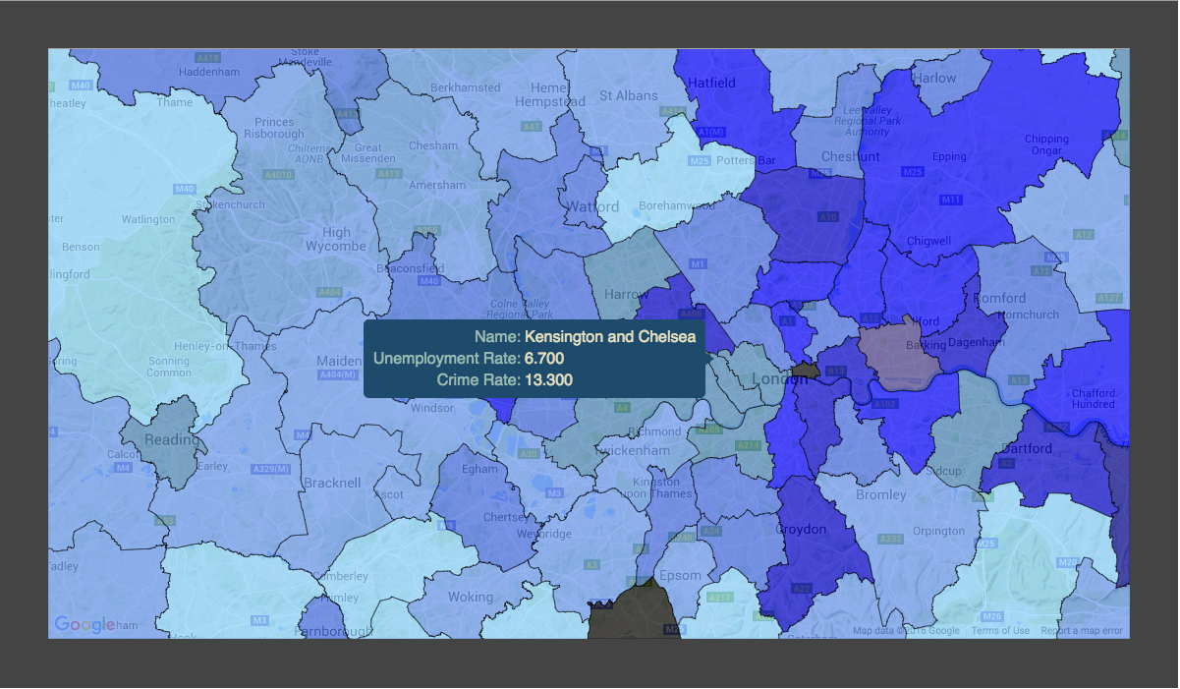
Exploratory Data Analysis
Shapefiles

Slide 13
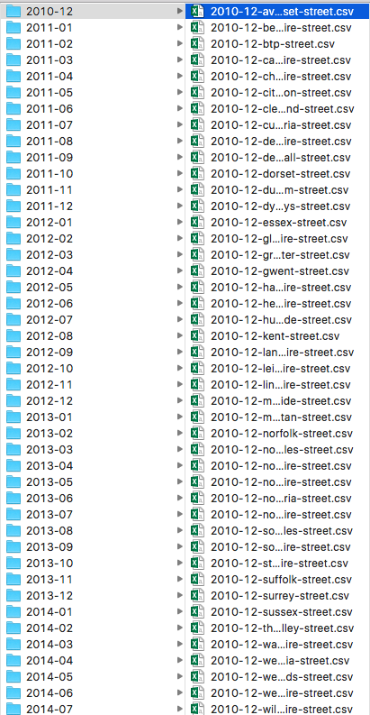
Spark
Collapse Data
62 folders (months) with ~50-150 datasets in each (45 police departments/constabularies with 1-3 types of data each)
About 6000 files
Hard to work with
Small files problem (<500k-3mb each)
Used Spark to collapse into 3 main files
Obtain counts by year/crime type/LAD
PySpark saved a lot of time
Especially with EMR v4.4

Slide 14
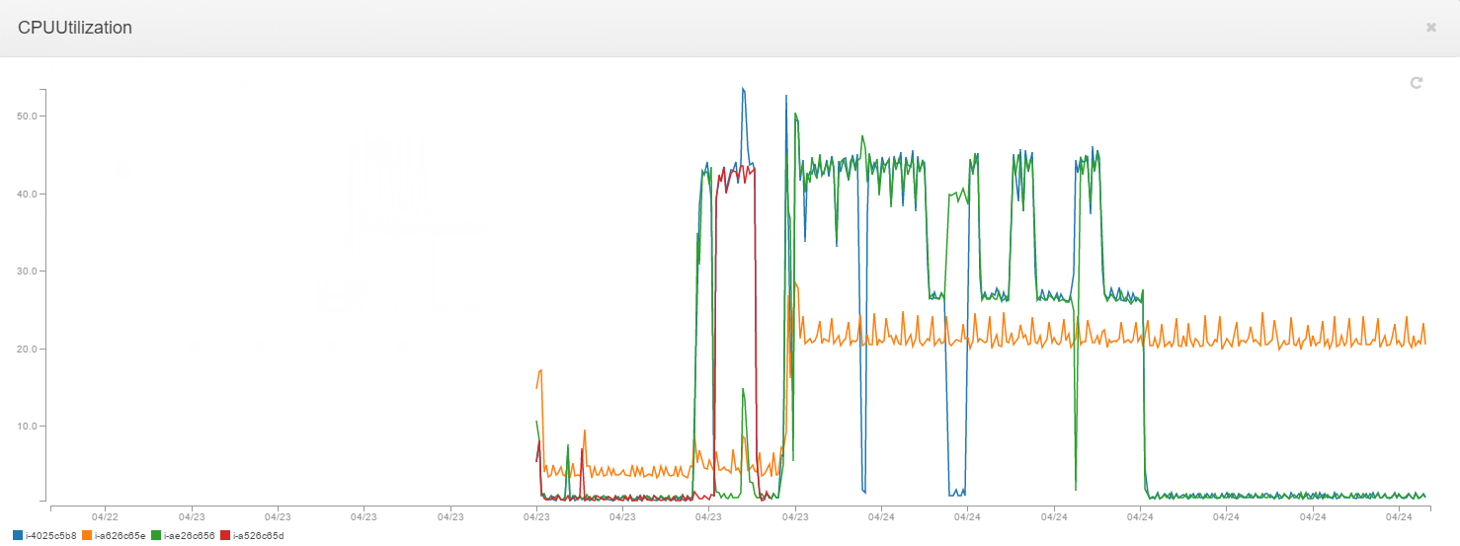
EMR 4.3 (Spark 1.6.0)
Nodes barely break 50% CPU utilization. Master node not pictured

Slide 15
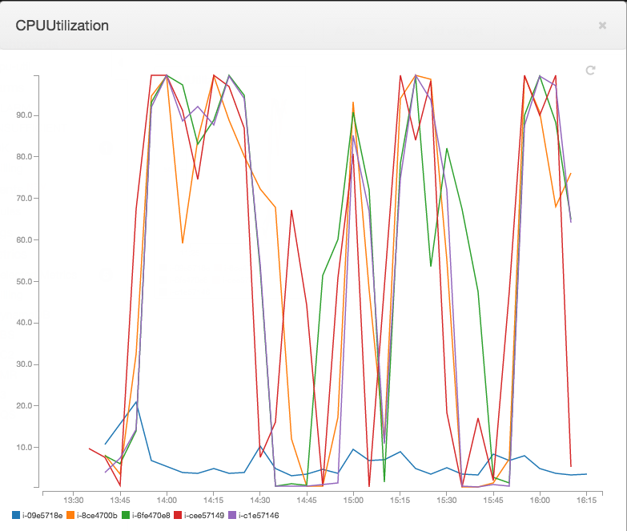
EMR 4.4 (Spark 1.6.0)
Most nodes over 90% CPU utilization most of the time. Master node shown in blue

Slide 16
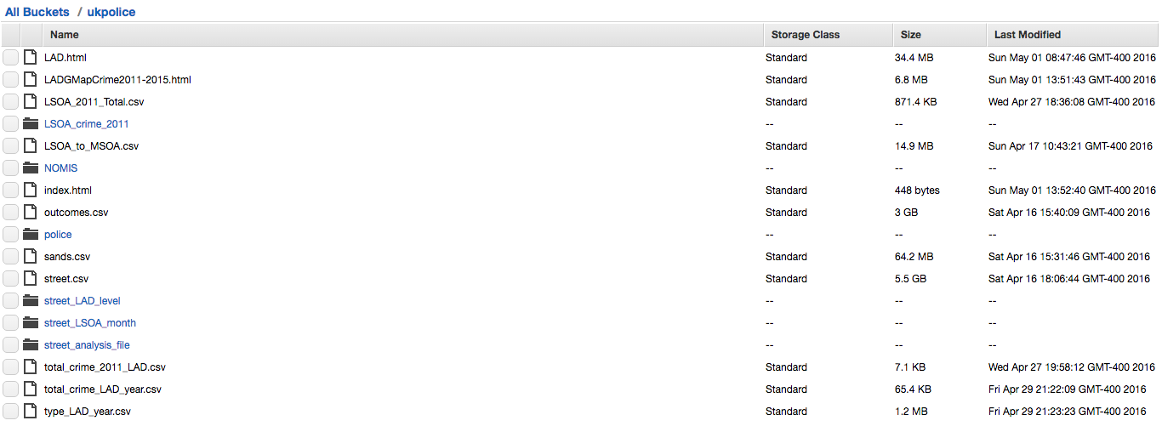
S3

Slide 17
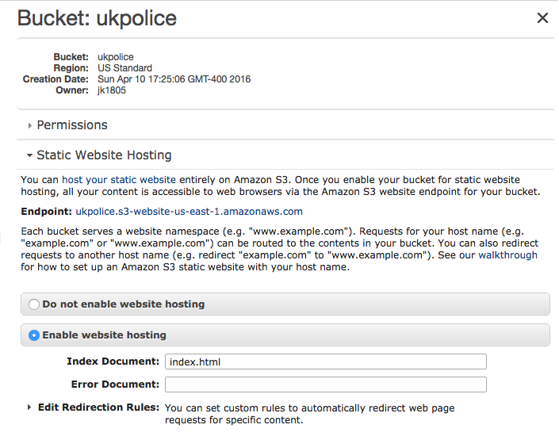
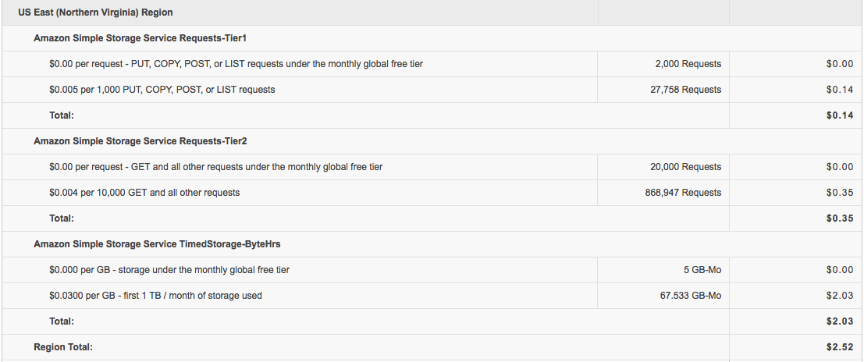
S3
ukpolice.s3-website-us-east-1.amazonaws.com

Slide 18
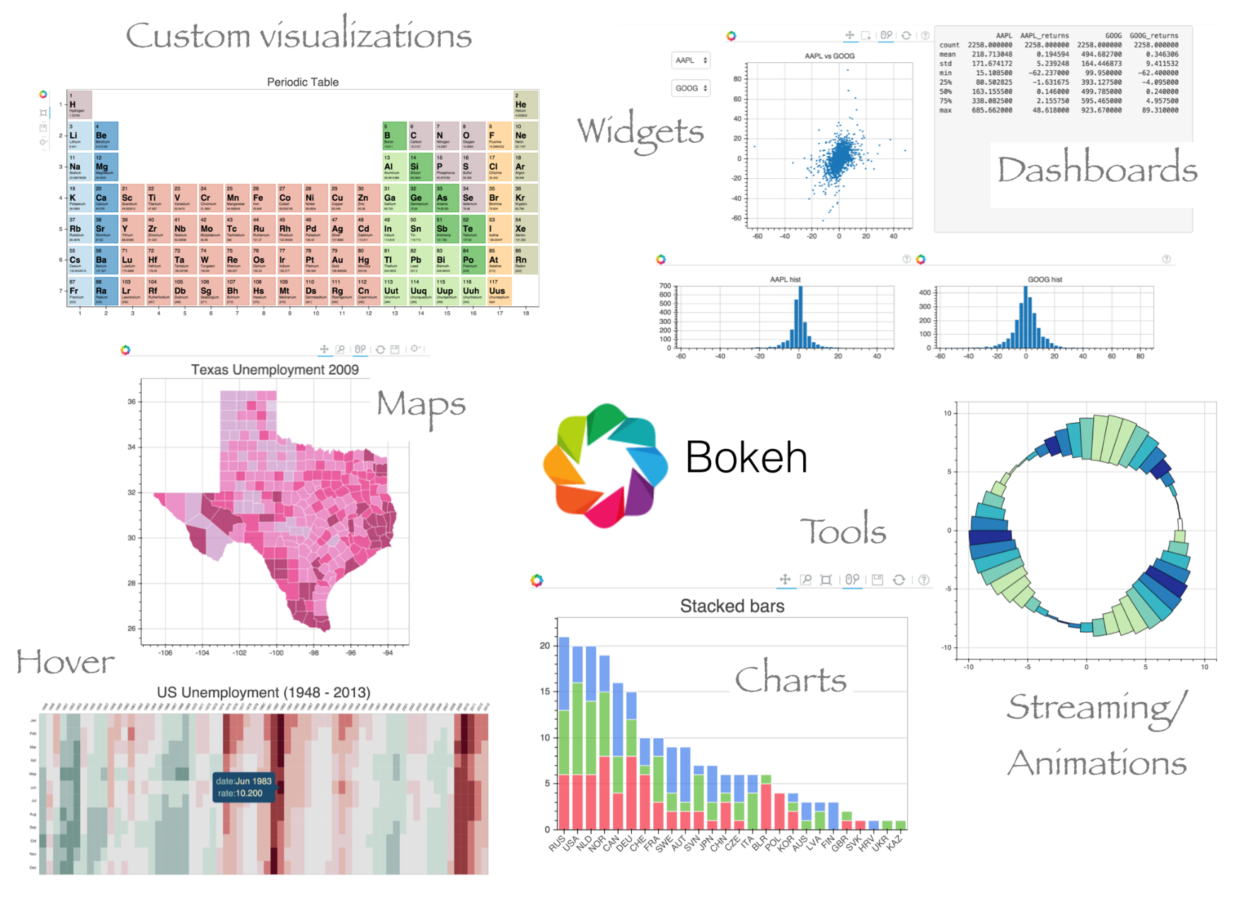
Python / Bokeh

Slide 19
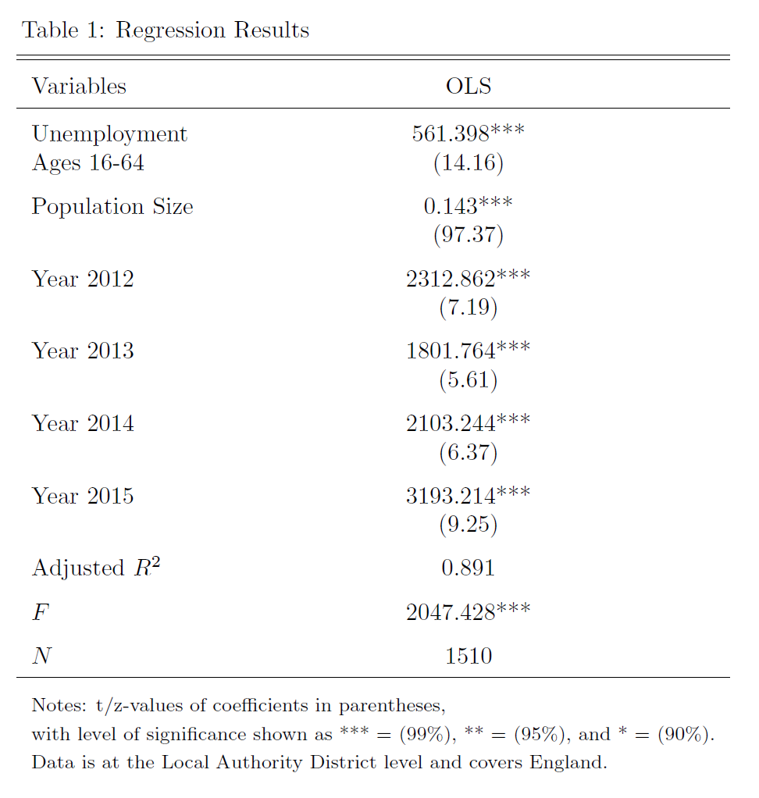
Analysis
Notes:
Our statistical analysis of the data was fairly simple, as much of our effort went towards wrangling the data and then using it to generate map visualizations and descriptive statistics, some of which you’ve seen already. For our statistical analysis we wanted to see if we could successfully predict the number of crimes in a local authority district using the demographic and economic indicators that we found. In particular, we tried to predict the number of crimes using unemployment between economically active members of the local authority district between the ages of 16 and 64. In order to control for at least one obvious source of variability in total crime, we also included population of the local authority districts as a predictor.
The method that we applied is the ordinary least squares linear regression technique.
Finally, we included a dummy variable for each year of the data that we used except for 2011. We are not naïve enough to believe that the only predictor of total crime is going to be unemployment, though we do believe it makes methodological sense for it to be one of the strongest. As such, including a Year dummy variable for each year helps us to approximately control for various economic factors that were not readily available, such as yearly mean or median household income, or GDP. I say that it would approximately control for those things because in their absence, the dummy variable for year is going to be given credit by the regression for variation that is actually caused by these missing macro-economic indicators changing between years.
Now I have introduced all 6 of the predictors that we used to predict total crime. As you can see, all of the predictors were statistically significant at a 99% confidence level, and the adjusted R^2 was 0.891, indicating that these 6 predictors can, together, explain approximately 89.1% of the variation in total crimes across local authority districts. It is clear that the model has explanatory power as indicated by the F statistic. There were 1510 records in the regression. That is one record per year per local authority district between 2011 and 2015. There were about 150 records that had to be removed prior to running the regression due to missing data.
I will speak more about these predictors and their significance as we move forward.

Slide 20
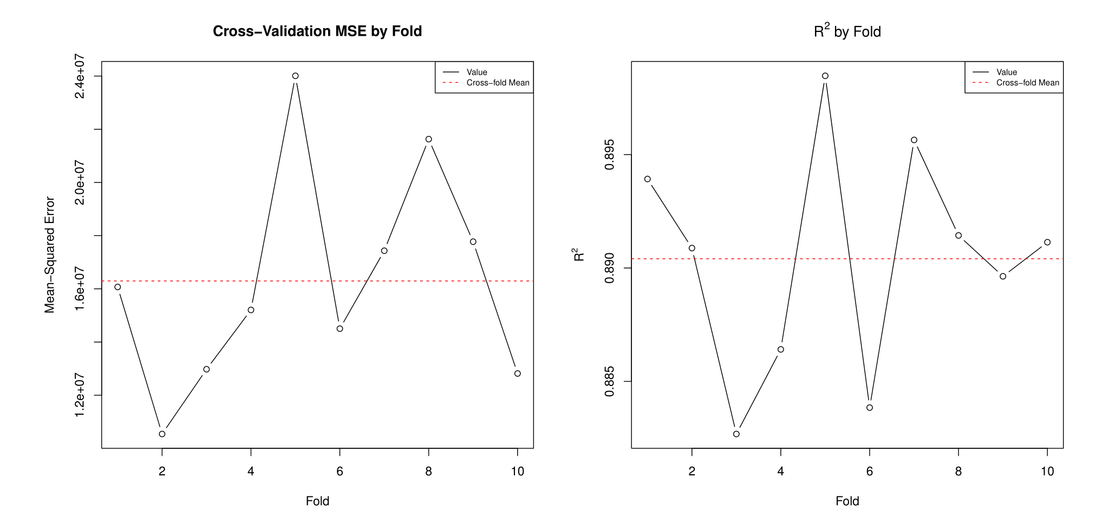
Analysis
Notes:
In order to perform validation on our analysis, we used 10-fold cross-validation.
Here you can see the results of 10-fold cross validation on our regression analysis. On the left you can see our mean-squared error, which is pretty high, just above 16 million. This indicates that, if we were to use this model to perform prediction, the predictions would be off, on average, by about 4000 crimes. For larger predictions that isn’t so bad, but the mean value of total crime in our data is 14280 and the median is just under 10,000. As a result, we would have to say that you would not want to use this model for prediction.
You might think that this is odd and unexpected given the graph on the right of R^2, which indicates that on average we explain approximately 90% of the variation in the data. Although the model can explain that, and indicates that the variables we included are relevant in the prediction of total crime, it also points to the other problem that I’ve already alluded to, which is omitted variable bias, which will be a theme as we continue to look at the cross-validation results and analyze this model.

Slide 21
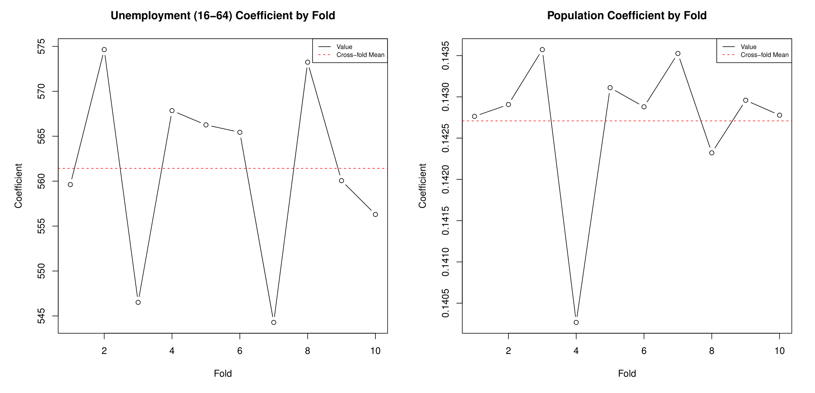
Analysis
Notes:
We were very happy with the stability of our model, and I am indicating it here by showing the coefficients for unemployment and population that were applied for each fold. Note that although the graphs look relatively variable, the scale on the y-axis is very small.
Note that our average coefficient for Unemployment was approximately 562, indicating that for each additional 1% of economically active 16 to 64 year olds that are unemployed, there will be, on average, 562 more crimes.
The coefficient for Population indicates that, ceteris paribus, we would expect another crime for every 7 people in the local authority district. Recall that “crimes” are loosely defined here, as “anti-social behavior” is the most common crime in our data.

Slide 22
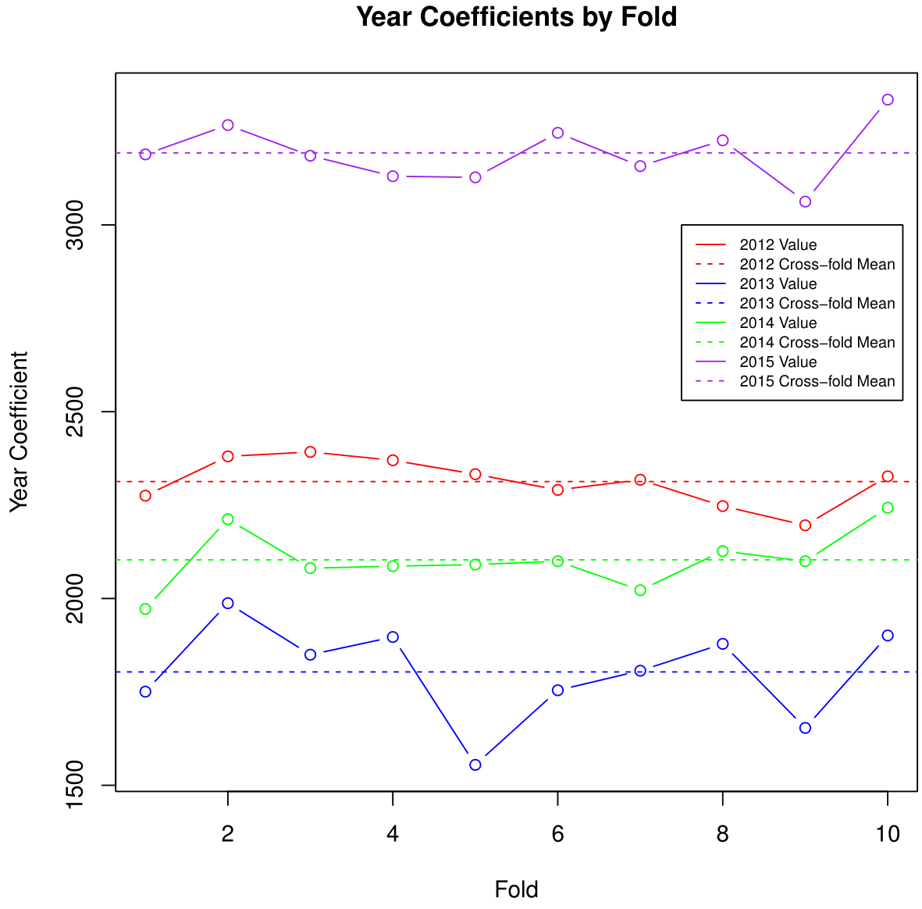
Analysis
Notes:
Finally, we can take a look at the variance of the coefficients across years and within year across folds. Again, these values are very stable. Recall that these have to be considered in relation to 2011. So if 2011 is considered the baseline, then we could interpret the 2012 year coefficient on the first fold to mean that on average, in 2012 there are roughly 2300 more crimes than there were in 2011.
Unfortunately, with such high magnitudes and a non-trivial variance, since we have no methodological reason to believe that one year should be so different from the others, we can put the nail in the coffin of the omitted variable bias theory. The year variable is clearly acting as a proxy for other variables that should have been included in the regression, were they available, but are not. Given the large magnitude of these coefficients and the high variance among them, we would need to be even more careful about predicting values outside of the time range of our data than we are with predictions without our time range.

Slide 23
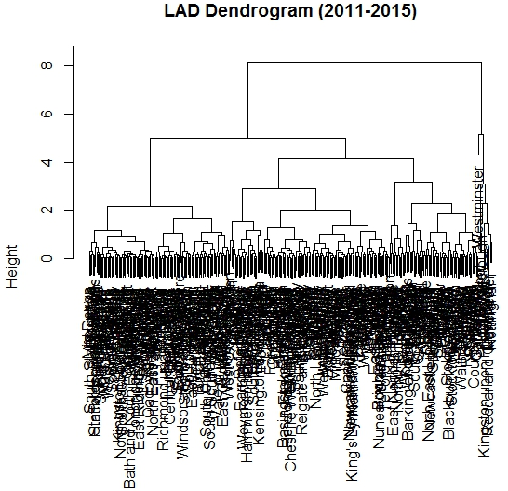
Analysis
Cluster 1: 128 LADs
Cluster 2: 71 LADs
Cluster 3: 113 LADs
Cluster 4: 10 LADs
Cluster 5: 1 LAD
Westminster

Slide 24
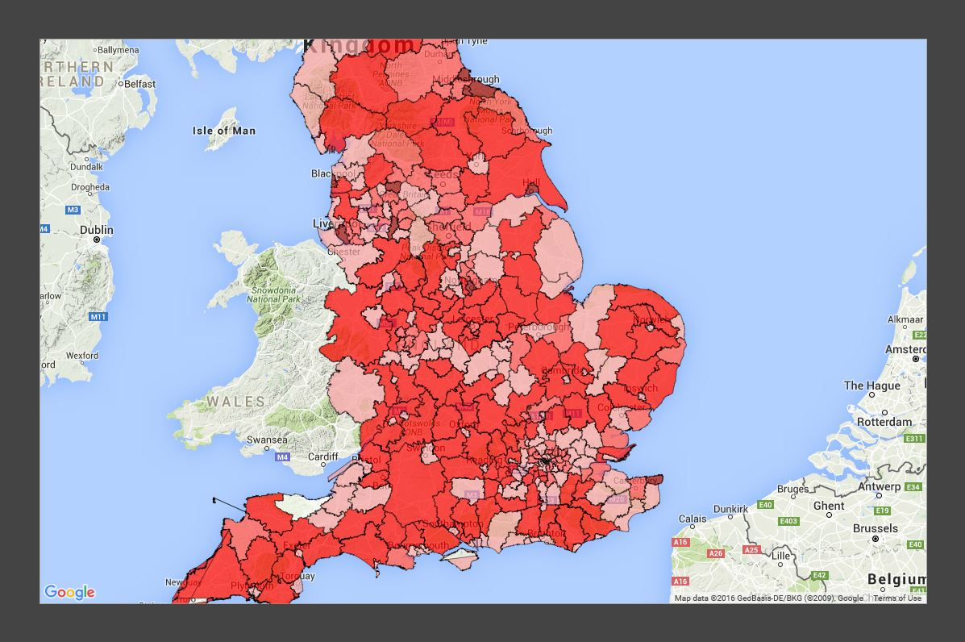
Analysis

Slide 25
Work Timetable
Week 1
Download all data, upload to S3 bucket
Combine all small files into a big file for efficiency (Spark)
Investigate mapping options
Week 2
Start working to get aggregations of crime data
Clean Crime data
Create maps with Bokeh
Week 3
Determine primary level of analysis to LAD level.
Finish getting aggregations of crime data to the LAD level
Come up with feasible deliverables
Week 4
Perform formal analyses (OLS regression, clustering)
Finalize maps and create map gif
Prepare presentation materials
To do:
Write paper
Further flesh out existing analyses
Notes:
A lot of our work in this project was focused on data wrangling, storage, and learning the intricacies of our analysis tools, or learning them entirely. This did not come as a surprise, as those of us in the data analytics program have learned throughout that the data preparation stage takes the majority of the time. We also ran into unexpected issues and delays. For mapping, there were sheer size limitations that constrained what we could map, or how large the maps were (in one case, half a gigabyte), or how long they took to load. In data wrangling, we were able to create files, but had issues saving them in formats that could be easily loaded up again. There were delays due to unforeseen unsupported features. For example, Spark cannot perform nested queries – and it took awhile to apply the workaround. All of these issues and delays contributed to a need to constantly revise our goals and expectations for the project. We don’t expect to further our analysis much during finals. We will polish our existing analyses and write the paper, but due to competing demands from other courses, we anticipate that will be the majority of our remaining accomplishments.

Slide 26
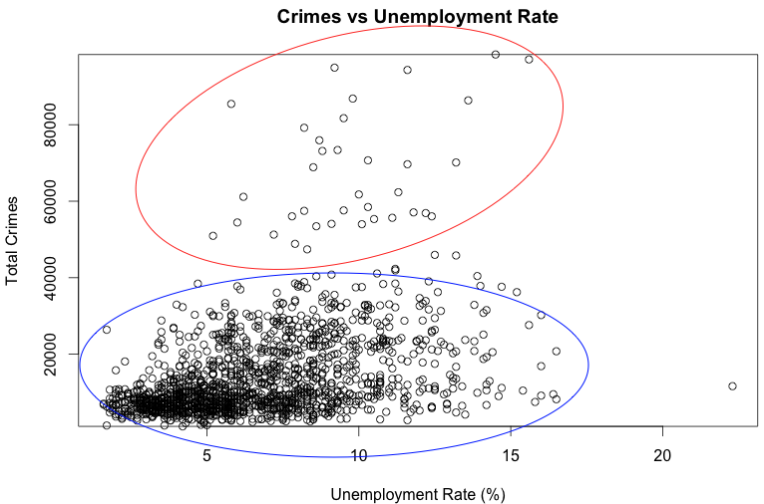
Extensions
Possible clusters?

Slide 27
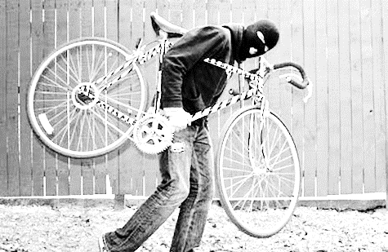
Extensions
What to do with crime type data?
Case studies
.
LAD_name | Year | Crime_type | Count
Bristol | 2013 | Vehicle crime | 3264
Bristol | 2016 | Robbery | 28
Bristol | 2016 | Theft from the person | 48
Bristol | 2013 | Criminal damage and arson | 4761
Bristol | 2013 | Violent crime | 2268
Bristol | 2016 | Burglary | 389
Bristol | 2011 | Other crime | 7804
Bristol | 2011 | Drugs | 551
Bristol | 2011 | Robbery | 550
Bristol | 2015 | Bicycle theft | 1572
Bristol | 2012 | Anti-social behaviour | 14347
Bristol | 2015 | Public order | 3113
Bristol | 2014 | Other theft | 5224
Bristol | 2011 | Burglary | 4718

Slide 28
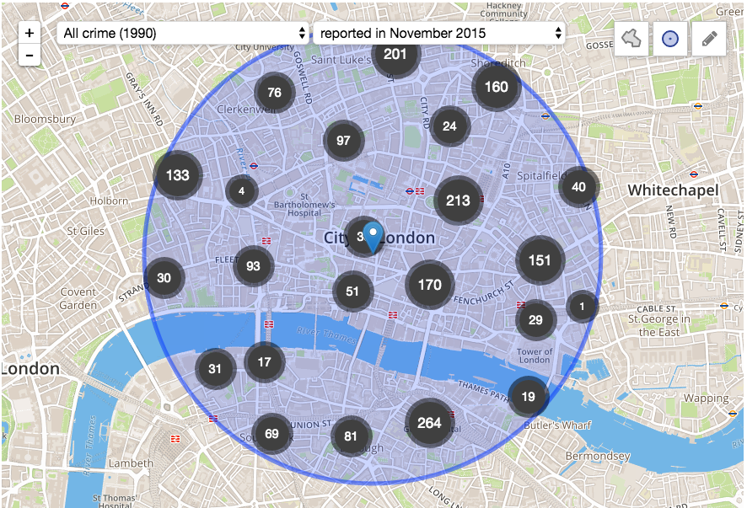
Extensions
Add more features to maps
Look into other platforms (e.g. OpenStreetMaps)

Slide 29
Extensions
Expand to other datasets
US Police Data Initiative
“21 police departments have committed to release a combined total of 101 data sets… The types of data include uses of force, police pedestrian and vehicle stops, officer involved shootings…” – May, 2015
Total is now 53 committed police departments, and counting:

